Slide 1
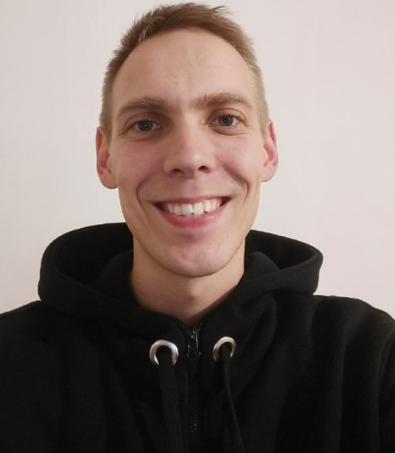
Shortly about myself
An open person with a desire for self-development and learning, I have over 10 years of experience in networking and information technology.
I think, that the key to success in any business is hard work, a good sense of humor and striving for the best.

Slide 2
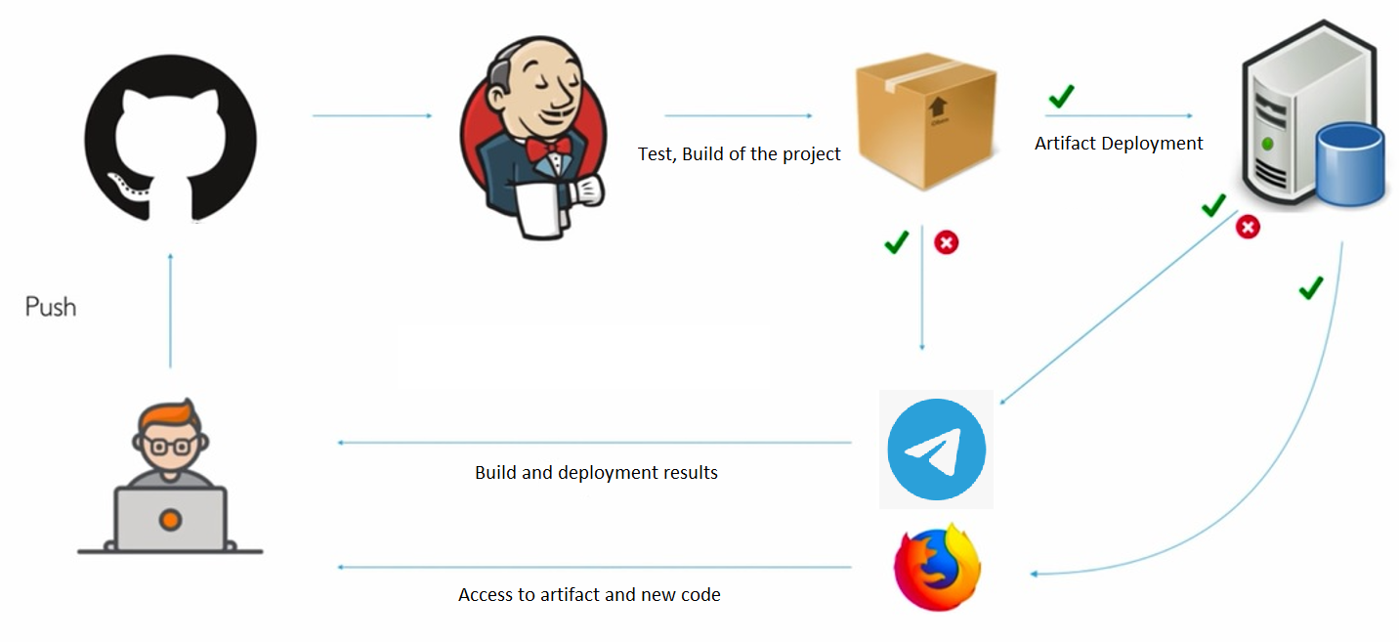
My goal

Slide 3
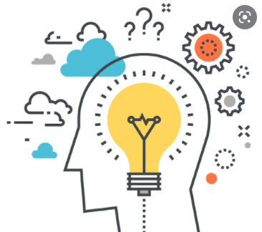
Main questions :
I have a resource limit (time, money, equipment, experience…), what tools can I use?
Location of the servers, services, type of network (Cloud solutions, VirtualBox, Linux OS or Microsoft Windows OS, MacOS).
How can Jenkins know about a new commit in the repository (push and pull paths)?
I need a reproducible and fast infrastructure creation with backup.
I need to have pipeline status notifications.
The whole process must be secure.

Slide 4
Tools used:
OC Microsoft Windows 10 (host computer).
Vagrant by HashiCorp.
Virtual Box Oracle VM:
- Ubuntu 20.04 LTS (bridged):
- Jenkins.
- Docker:
- Apache Maven.
- Telegram Bot.
Git hub
Docker Hub

Slide 5
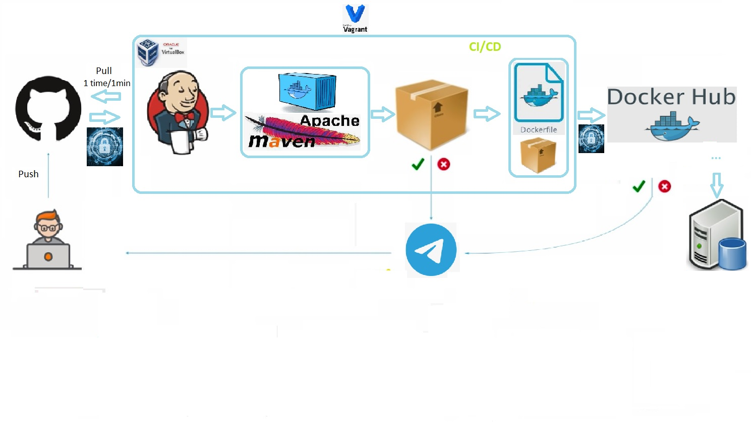
My pipeline

Slide 6
CI (continuous integration) process
The developer pushes the code to Git HUB.
Jenkins job sends a request to GIT HUB 1 time per minute. When it sees the changes in the repository, the pipeline will start.
The job starts a Docker container with Maven that builds and tests the project.
The result of the CI process is ARTIFACT.

Slide 7
CD (continuous delivery) process
In the current pipeline, delivery starts with building the docker image.
When the image is ready, it is sent to Docker Hub.
From Docker Hub, the image can be pushed to the QA environment, to the stage/production server.

Slide 8
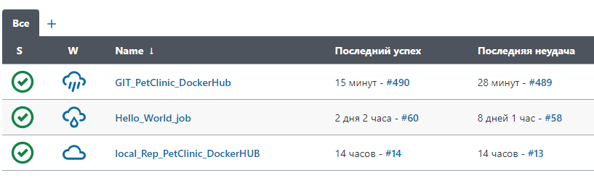
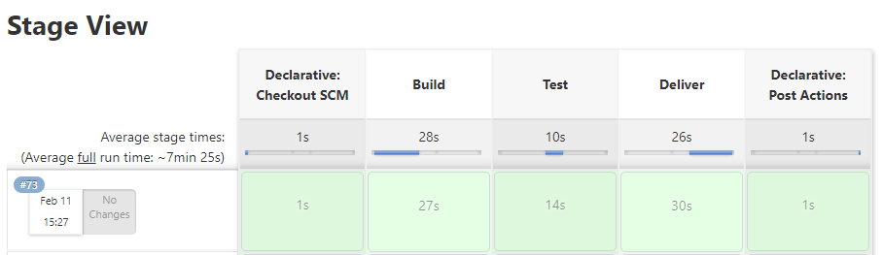
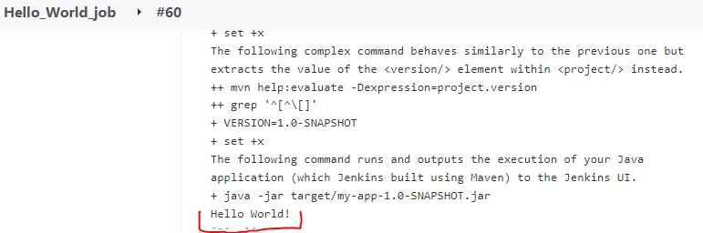

Slide 9
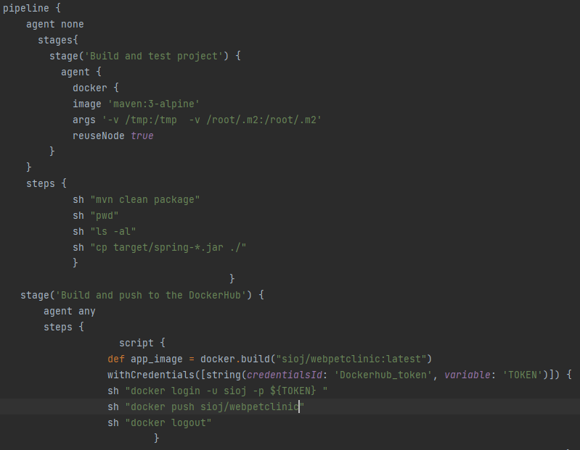

Slide 10
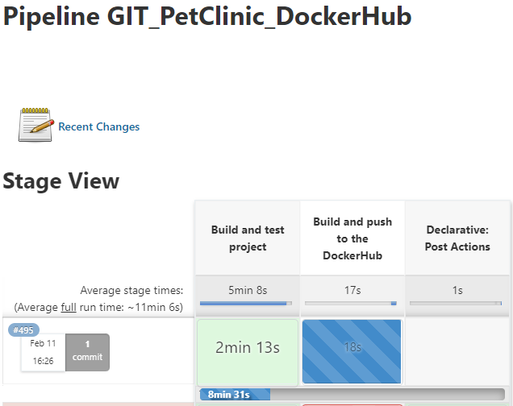
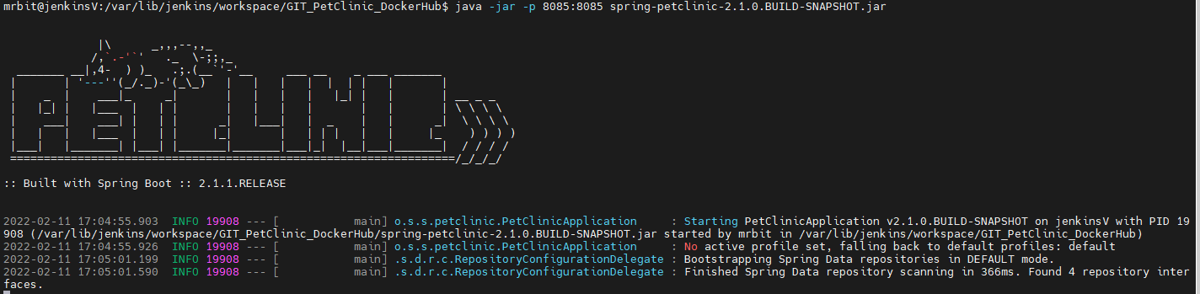
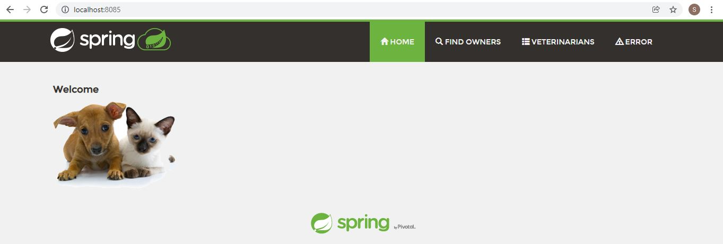
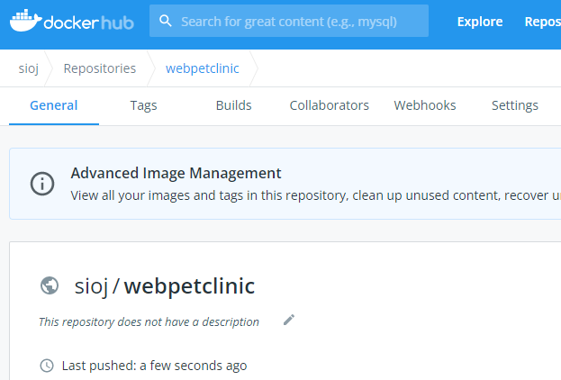

Slide 11
Q & A

